Slide 1
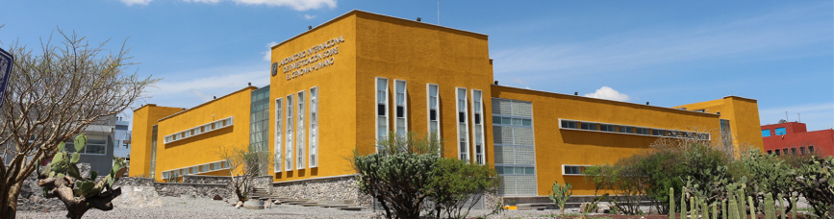

The underrepresentation of non-European samples in genomic studies: An overview and ethical considerations
C. Daniela Robles Espinoza, Ph.D.
Cancer Genetics and Bioinformatics Group
International Laboratory for Human Genome Research, UNAM
Cancer Genome Analysis course, October 2025
www.liigh.unam.mx/drobles
drobles@liigh.unam.mx
@daniela_oaks

Slide 2
Outline
Background: The importance of studying diverse populations to understand disease processes
What is the problem?
Very little representation of non-European samples in public repositories
Very few studies being conducted outside de Global North
Why does it exist?
Lack of support for studies being conduced in the Global South
‘Helicopter’ science
How can we solve it?
More equitable scientific partnerships
Facilitating access to funding
Expanding representation in scientific boards, conferences, etc
Conclusions

Slide 3
Outline
Background: The importance of studying diverse populations to understand disease processes
What is the problem?
Very little representation of non-European samples in public repositories
Very few studies being conducted outside de Global North
Why does it exist?
Lack of support for studies being conduced in the Global South
‘Helicopter’ science
How can we solve it?
More equitable scientific partnerships
Facilitating access to funding
Expanding representation in scientific boards, conferences, etc
Conclusions

Slide 4
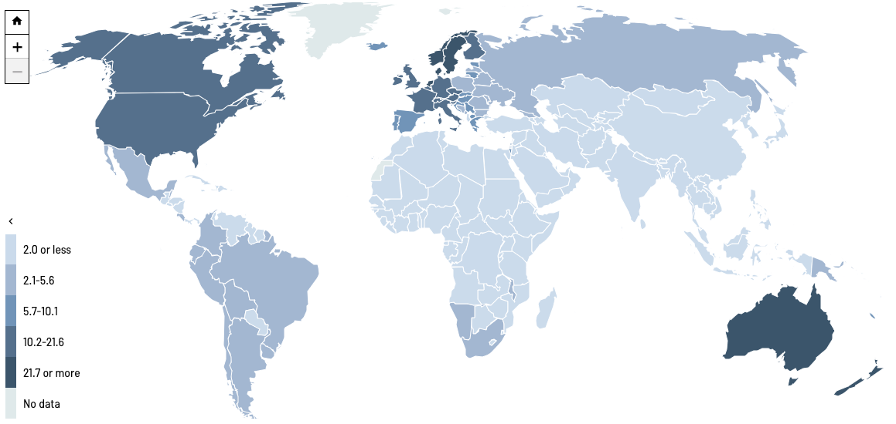
Why is it important to study disease across different populations? Cancer as an example
Example: Melanoma incidence
Site-specific cancer incidence rates vary up to 50-fold between geographic areas (The Cancer Atlas)
These differences are due to
Genetic risk factors
Lifestyle and environmental exposure
Implementation of effective cancer control measures
ASR per 100,000
The Cancer Atlas, 2018
Notes:
So why is it important to study cancer across different populations? We know that site-specific cancer incidence rates vary up to 50 fold between geographic regions, and here as an example I am showing a map from The Cancer Atlas displaying the melanoma incidence rate throughout the world, where you can appreciate the large differences among countries

Slide 5




Why is it important to study disease across different populations? Cancer as an example
Example: Melanoma incidence
Site-specific cancer incidence rates vary up to 50-fold between geographic areas (The Cancer Atlas)
These differences are due to
Genetic risk factors
Lifestyle and environmental exposure
Implementation of effective cancer control measures
ASR per 100,000
The Cancer Atlas, 2018
Notes:
These patterns of variation in incidence are seen for many different types of cancer, and we know that these differences are due to a combination of the influence of genetic risk factors, lifestyle and environmental exposure and the implementarion of effective cancer control measures.
by studying a diverse set of samples, we can shed light into the first two points here

Slide 6
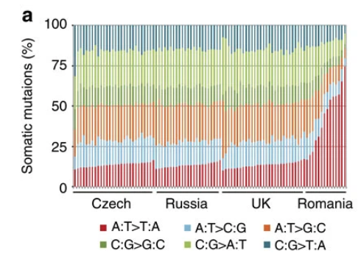
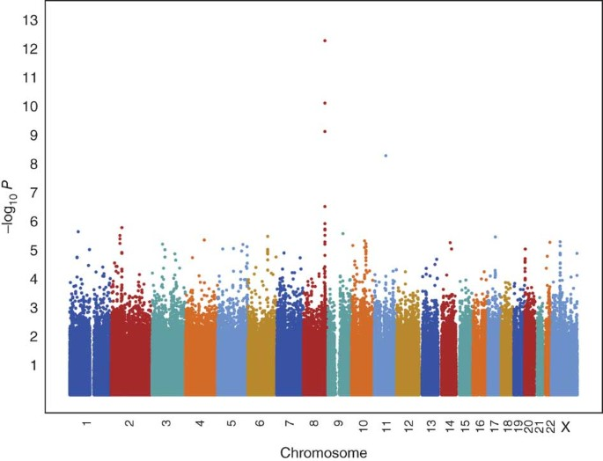
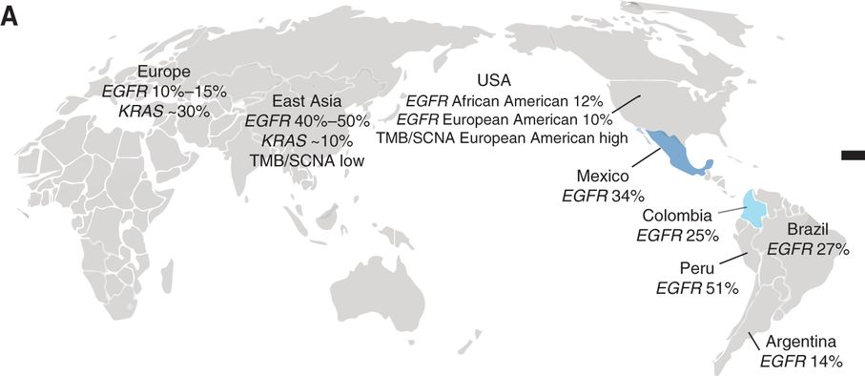
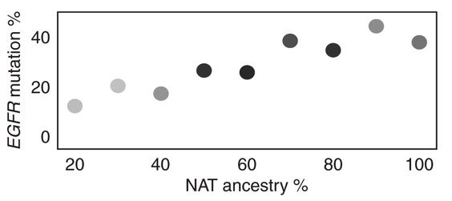
Traditional genomic studies have uncovered distinct genetic and environmental risk factors across populations
Germline predisposition
Genomic profiling
Correlation analyses
Prostate cancer in men of African ancestry
Clear cell renal cell carcinoma in Romania
Lung cancer in East Asians and Latin Americans
-log₁₀P
Chromosome
Carrot-Zhang et al (2021)
Freedman et al (2006) Haiman et al (2011)
Scelo et al (2014)
Ancestry-specific genetic risk factors
Differing environmental exposures
Correlation between ancestry and genomic profile
Notes:
First, germline predispoition studies, specifically GWAS and admixture mapping, have been able to uncover risk alleles that are more frequent in underrepresented populations, in this case a region in chromosome 8 that contains several prostate cancer susceptibility alleles that are much more common in men of African descent, and that explain a proportion of the increased prostate cancer risk seen in this population

Slide 7
Traditional genomic studies have uncovered distinct genetic and environmental risk factors across populations
Germline predisposition
Sample genomic profiling
Correlation analyses
Prostate cancer in men of African ancestry
Clear cell renal cell carcinoma in Romania
Lung cancer in East Asians and Latin Americans
-log₁₀P
Chromosome
Carrot-Zhang et al (2021)
Freedman et al (2006) Haiman et al (2011)
Scelo et al (2014)
Ancestry-specific genetic risk factors
Differing environmental exposures
Correlation between ancestry and genomic profile
Notes:
Additionally, tumour genomic profiling in patients with clear cell renal cell carcinoma from across Europe was able to identify a different pattern of mutations in patients from Romania, which was later ascribed to exposure to aristolochic acid

Slide 8
Traditional genomic studies have uncovered distinct genetic and environmental risk factors across populations
Germline predisposition
Sample genomic profiling
Correlation analyses
Prostate cancer in men of African ancestry
Clear cell renal cell carcinoma in Romania
Lung cancer in East Asians and Latin Americans
-log₁₀P
Chromosome
Carrot-Zhang et al (2021)
Freedman et al (2006) Haiman et al (2011)
Scelo et al (2014)
Ancestry-specific genetic risk factors
Differing environmental exposures
Correlation between ancestry and genomic profile
Notes:
And finally, in this study, correlation analyses between the rate of mutation of lung cancer drivers such as EGFR and KRAS and the proportion of ancestry from different populations was able to partly explain the geographic differences seen in the rate of driver mutations, with a higher proportion of native american ancestry being positively correlated with EGFR mutation rate

Slide 9
Traditional genomic studies have uncovered distinct genetic and environmental risk factors across populations
Germline predisposition
Sample genomic profiling
Correlation analyses
Prostate cancer in men of African ancestry
Clear cell renal cell carcinoma in Romania
Lung cancer in East Asians and Latin Americans
-log₁₀P
Chromosome
Carrot-Zhang et al (2021)
Freedman et al (2006) Haiman et al (2011)
Scelo et al (2014)
Ancestry-specific genetic risk factors
Differing environmental exposures
Correlation between ancestry and genomic profile
Notes:
All of these are examples where an analysis of the genome through these different approaches have revealed new knowledge - ancestry-specific genetic risk factors, the effect of environmental exposures on the tumour genome, and the possible impact of genetic ancestry on the tumour somatic genomic profile

Slide 10
To have a good understanding of disease biology, it is of utmost importance to study indivudals from different populations and geographical regions

Slide 11
Outline
Background: The importance of studying diverse populations to understand disease processes
What is the problem?
Very little representation of non-European samples in public repositories
Very few studies being conducted outside de Global North
Why does it exist?
Lack of support for studies being conduced in the Global South
‘Helicopter’ science
How can we solve it?
More equitable scientific partnerships
Facilitating access to funding
Expanding representation in scientific boards, conferences, etc
Conclusions

Slide 12
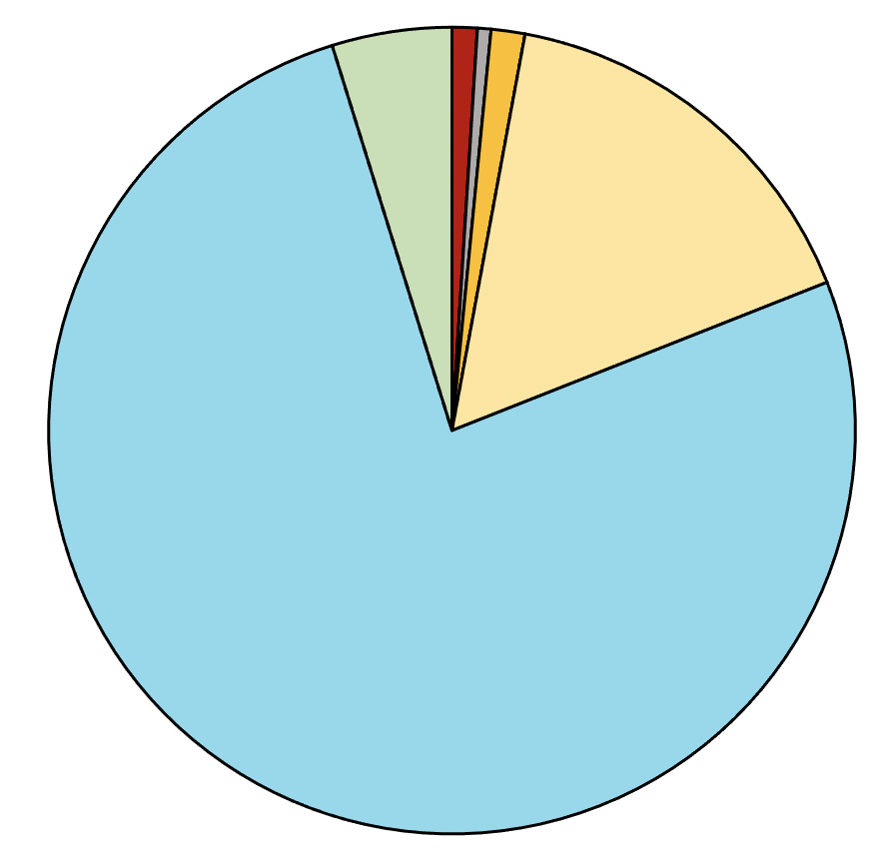
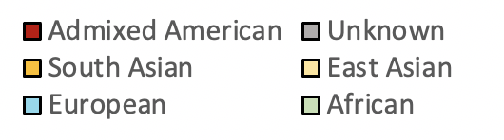
What is the problem? There is a gross underrepresentation of people of non-European descent in studies of cancer genomics
PCAWG (2020)
~1%
~1%
~17%
Notes:
Why the focus on Latin American patients? Well, it turns out that there is a gross underrepresentation of people of Amerindian and Latino ancestry in studies of cancer genomics. Here you are looking at a pie chart depicting the primary ancestry of the nearly 2,700 participants of the Pan-Cancer Analysis of Whole Genomes, and you can see, in red the Admixed American anestry – approximately 1% of all samples

Slide 13
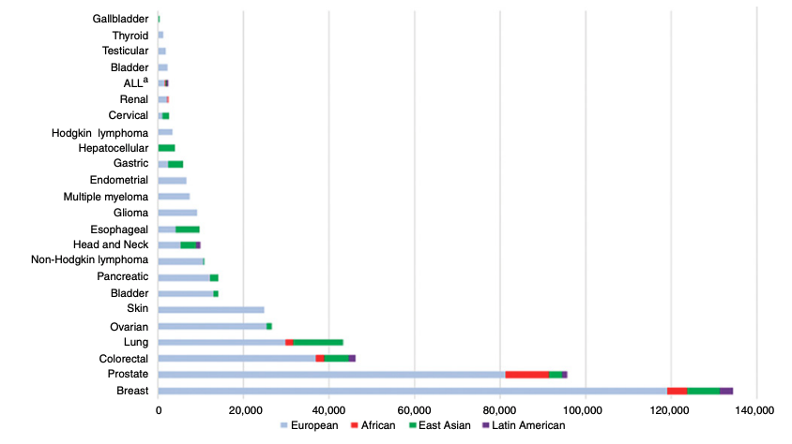
What is the problem? There is a gross underrepresentation of people of non-European descent in studies of cancer genomics
PCAWG (2020)
GWAS: number of cancer cases included in the discovery stage of GWAS by ancestral population and cancer site
~11% East Asian
~1% Latin American
~1%
~1%
~17%
Park, Cheng and Haiman (2018)
Notes:
SAS includes PJL (Punjabi, Pakistan), BEB (Bengali in Bangladesh), GIH (Gujarati Indians in Texas), ITU (Indian Telugu in UK), STU (Sri Lankan Tamil in UK)
EAS includes CHB (Han Chinese), JPT (Japanese), CHS (Southern Han Chinese), CDX (Chinese Dai), KHV (Vietnam)

Slide 14
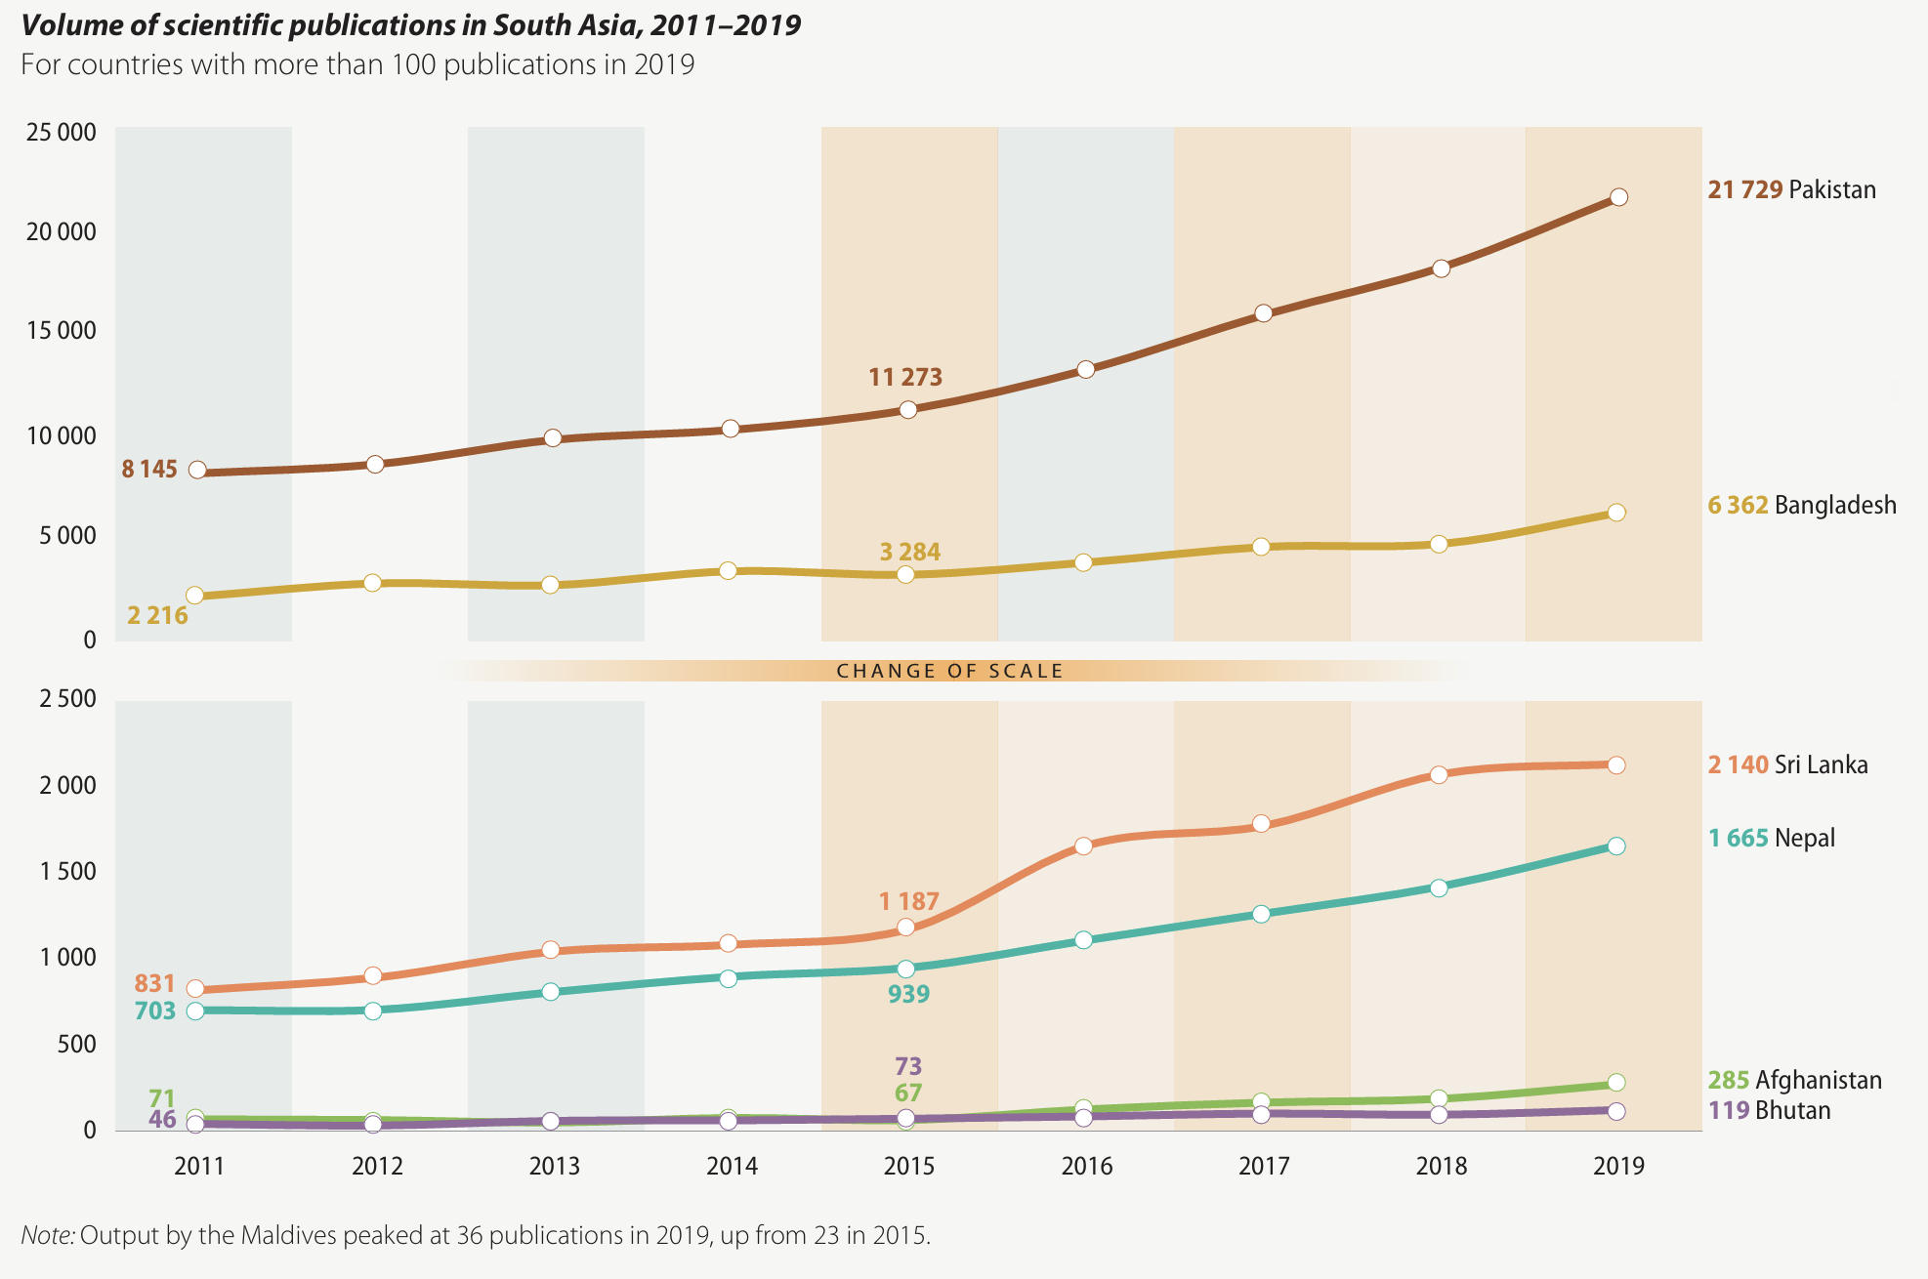
What is the problem? Few studies being conducted outside of the Global North (South Asia)
~160,000 UK
~160,000 India
~150,000 Germany
~100,000 Italy
~100,000 France
~80,000 Spain
UNESCO (2021)
Notes:
Linked to funding
ethics, government and banking regulations make doing this hard, but also of course, funding is probably the most important factor

Slide 15
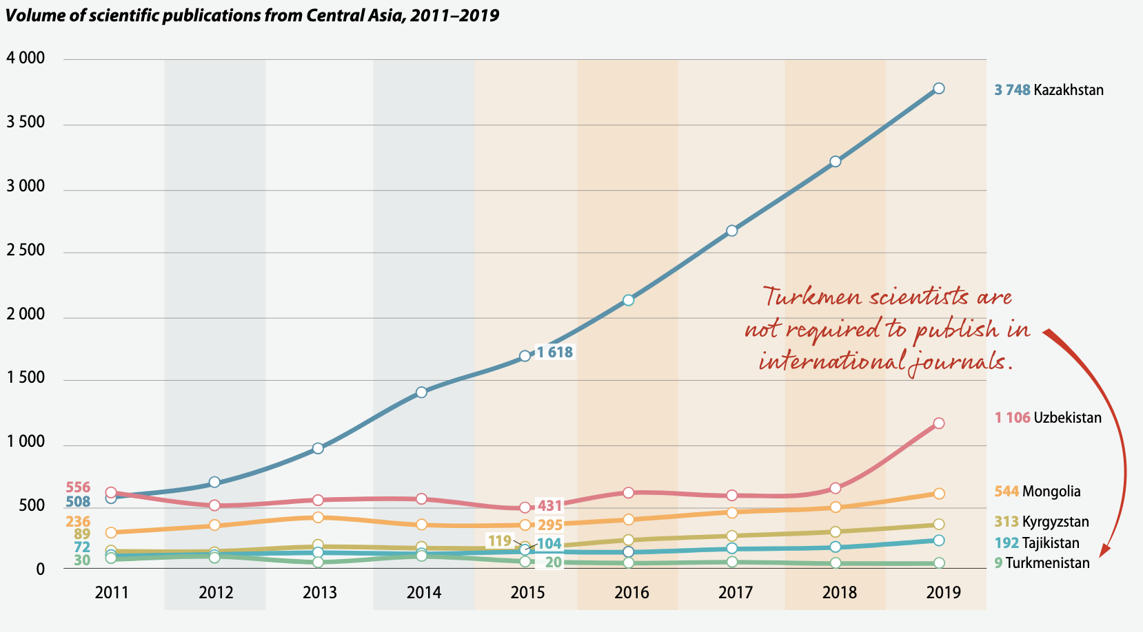
What is the problem? Few studies being conducted outside of the Global North (Central Asia)
~160,000 UK
~160,000 India
~150,000 Germany
~100,000 Italy
~100,000 France
~80,000 Spain
UNESCO (2021)
Notes:
Linked to funding
ethics, government and banking regulations make doing this hard, but also of course, funding is probably the most important factor

Slide 16
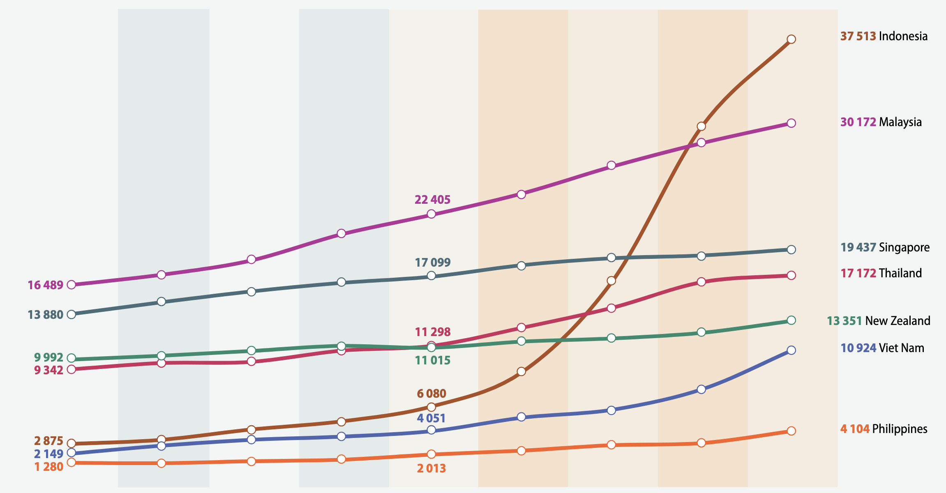
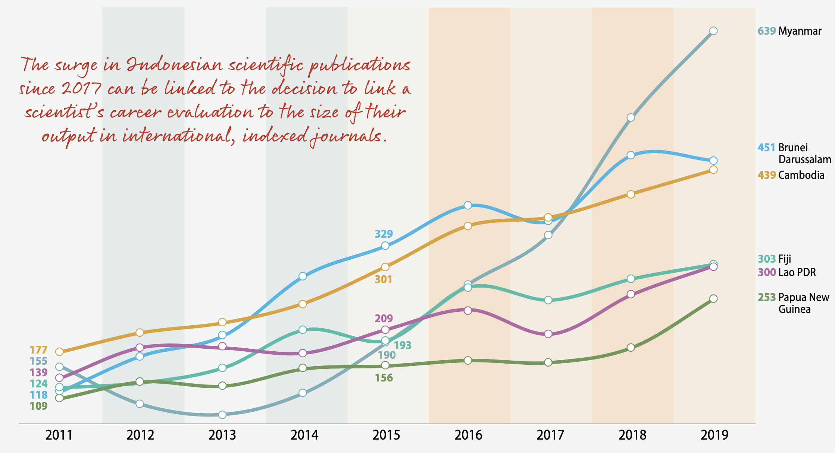
What is the problem? Few studies being conducted outside of the Global North (South East Asia & Oceania)
~160,000 UK
~160,000 India
~100,000 Italy
~100,000 France
~87,000 Australia
~80,000 Spain
UNESCO (2021)
Notes:
Linked to funding
ethics, government and banking regulations make doing this hard, but also of course, funding is probably the most important factor

Slide 17
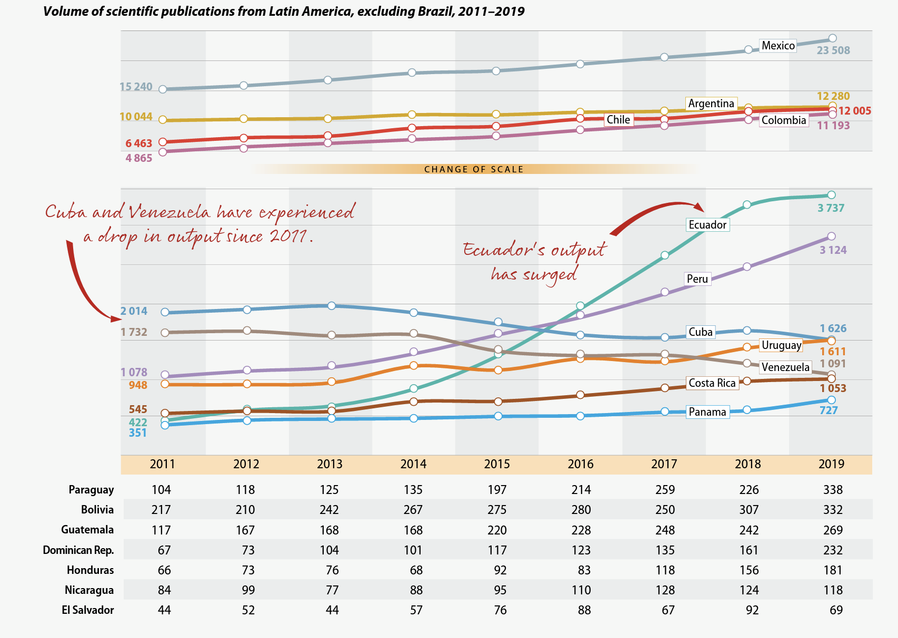
What is the problem? Few studies being conducted outside of the Global North
~160,000 UK
~150,000 Germany
~100,000 Italy
~100,000 France
~80,000 Spain
~74,270 Brazil
UNESCO (2021)
Notes:
Linked to funding
ethics, government and banking regulations make doing this hard, but also of course, funding is probably the most important factor

Slide 18
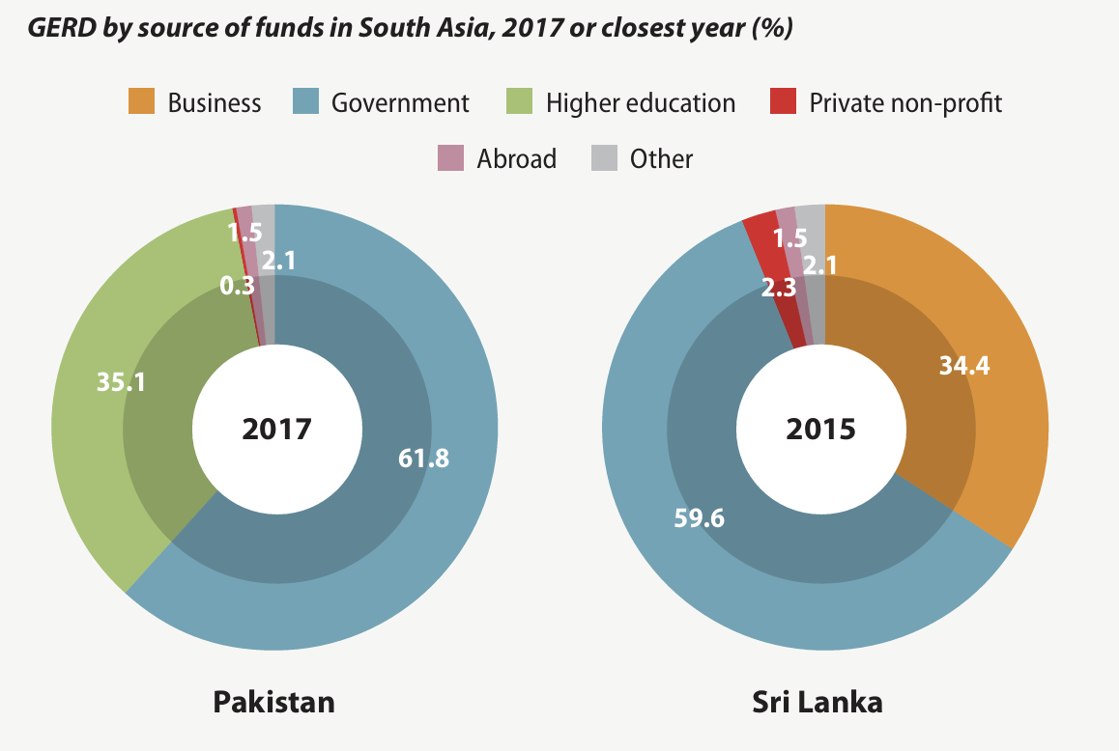
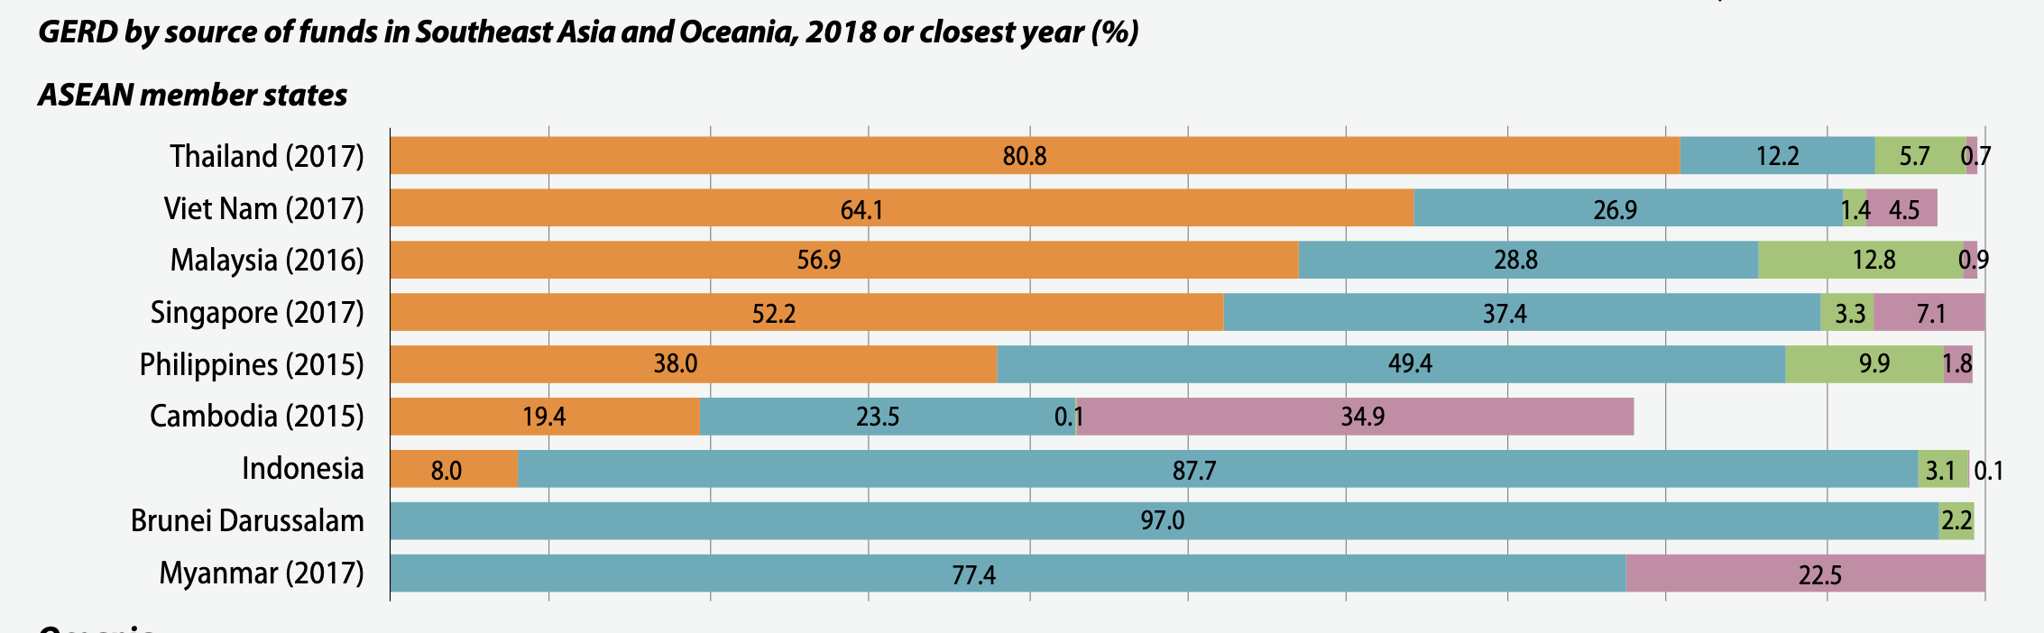
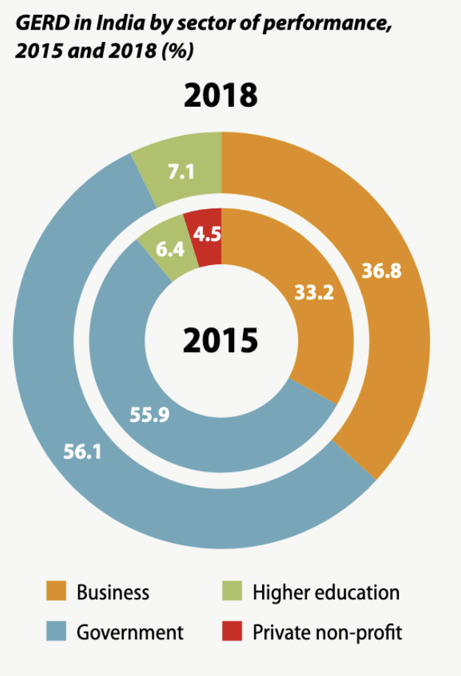
What is the problem? Much of the funding for Global South science is from the public sector
UNESCO (2021)
Notes:
Thailand: To promote industrial R&D, the Cabinet approved tax incentives in May 2017 for companies that form clusters to raise their investment in five priority areas, namely: food, agriculture and biotechnology; public health, health care and biomedical technology; robotics and smart devices; digital technology such as the Internet of Things and AI; and the creative economy, culture and lifestyle. Firms are entitled to a 300% tax rebate on their research expenditure (Theparat, 2018).
India: Since 2015, there has been a steady decline in share of R&D performed by the government sector (Figure 22.2). In parallel, the private business enterprise sector has raised its own contribution to 42% of the total. In theory, this is a positive trend, as it means that R&D is increasingly being performed by the same sector that has the capacity to convert research output into commercial products and processes. The challenge for India will be to ensure that the current increase in business expenditure on R&D becomes systematic, as has been the case for countries such as China and the Republic of Korea.

Slide 19
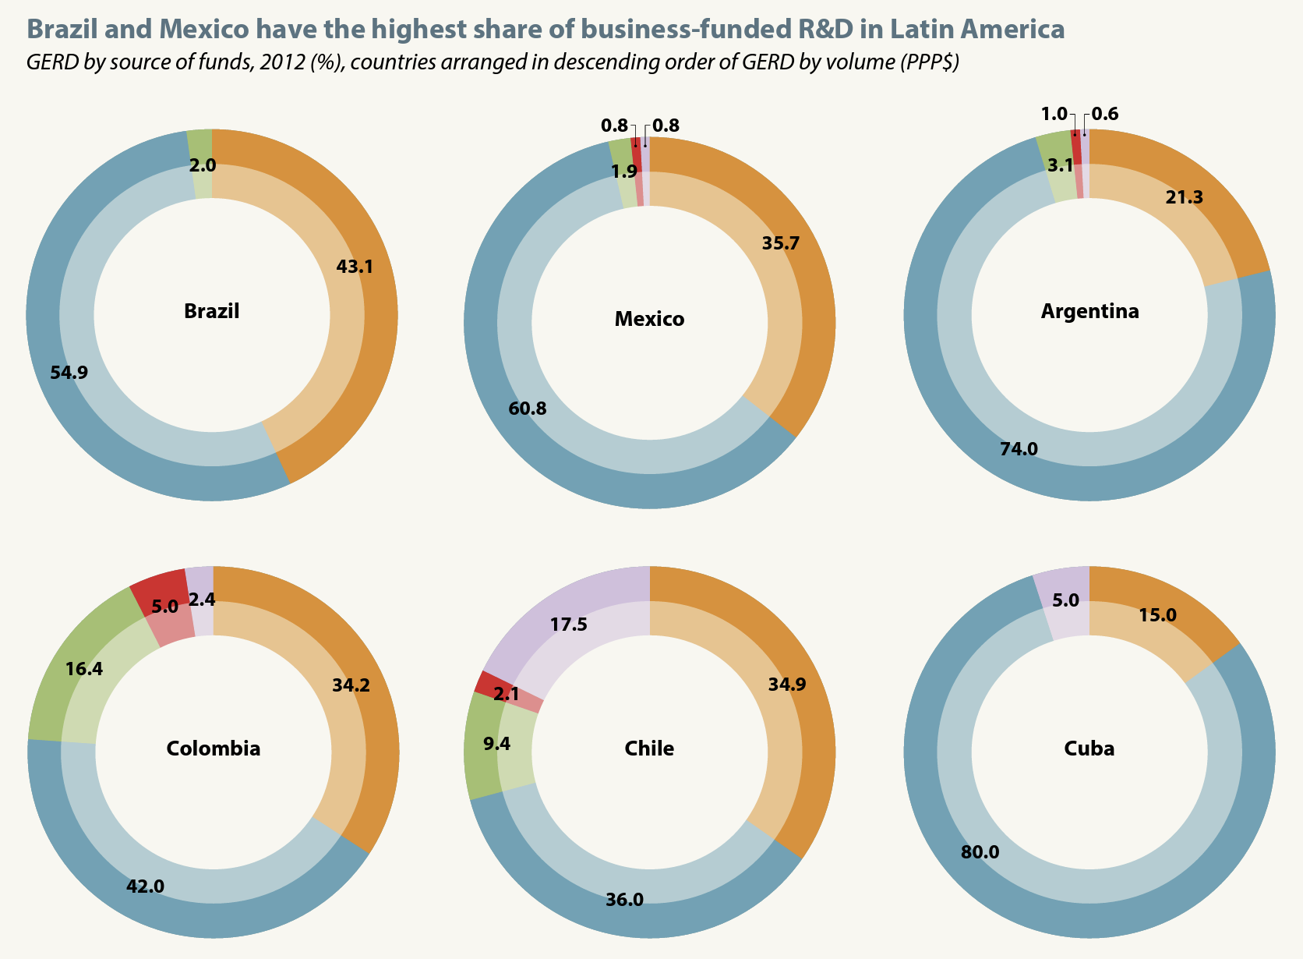
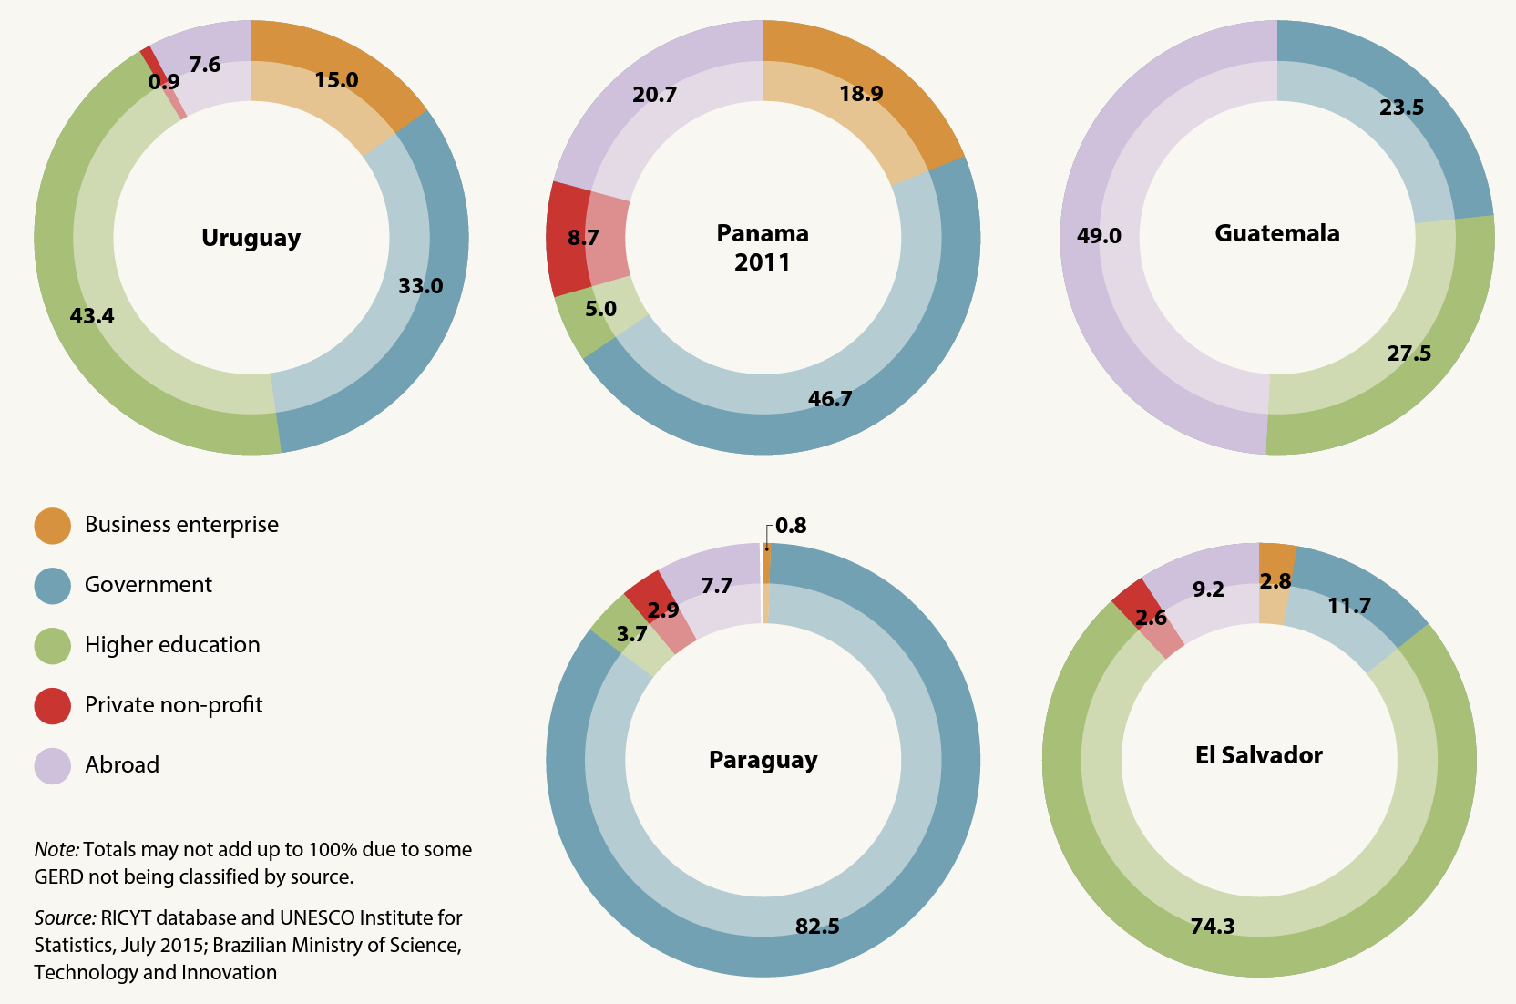
What is the problem? Most of the funding for Latin American science is from the public sector
UNESCO (2015)
Notes:
The public sector remains the main source of funding, particularly in Argentina, Cuba, Mexico and Paraguay. Businesses in the region contribute about 40% of R&D funding, on average (Figure 7.7), with Brazil slightly surpassing this share (see Chapter 8). The public sector still carries out the bulk of research. Six countries receive a considerable share of research funding from abroad: Chile, El Salvador, Guatemala, Panama, Paraguay and Uruguay

Slide 20
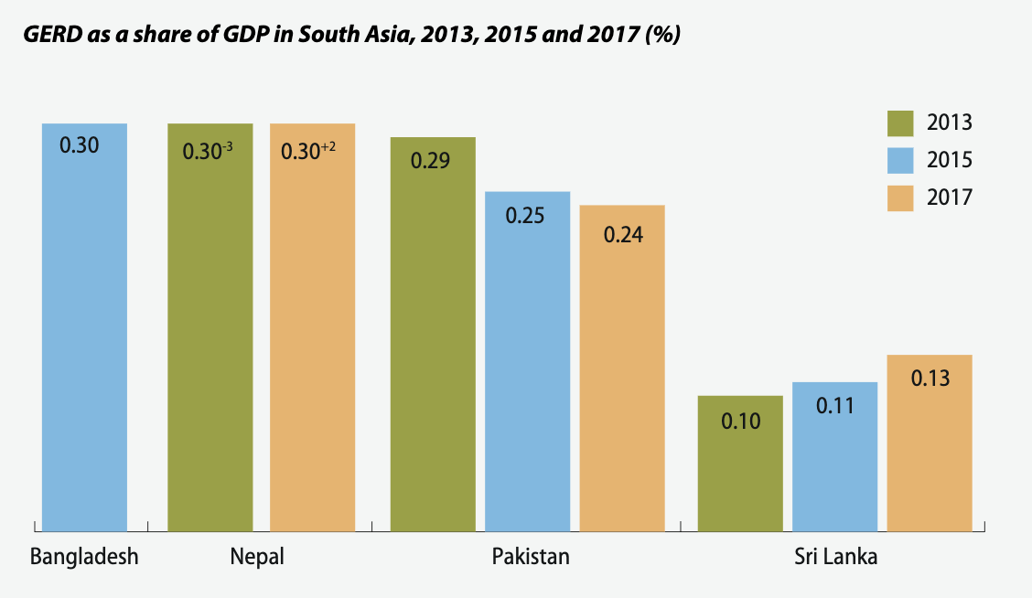
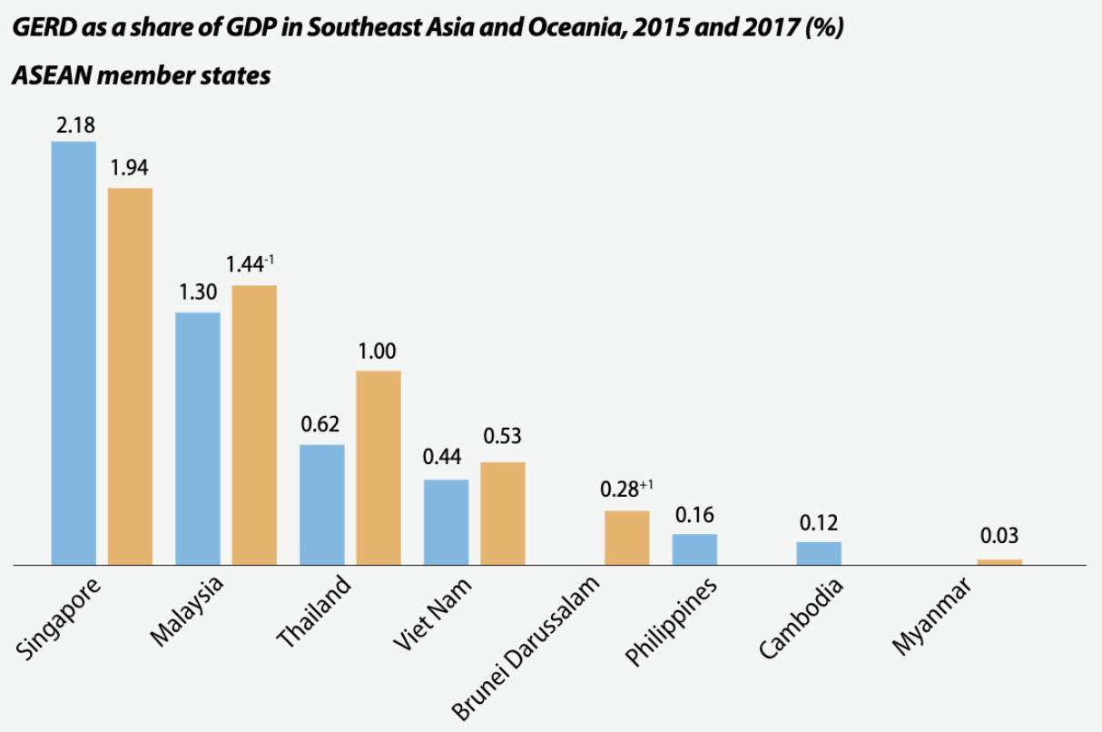
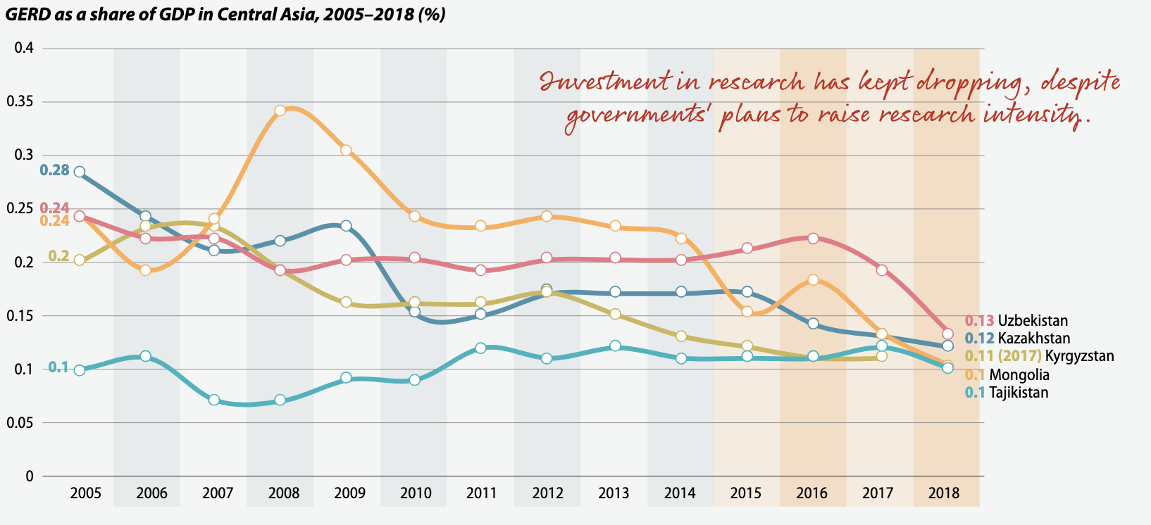
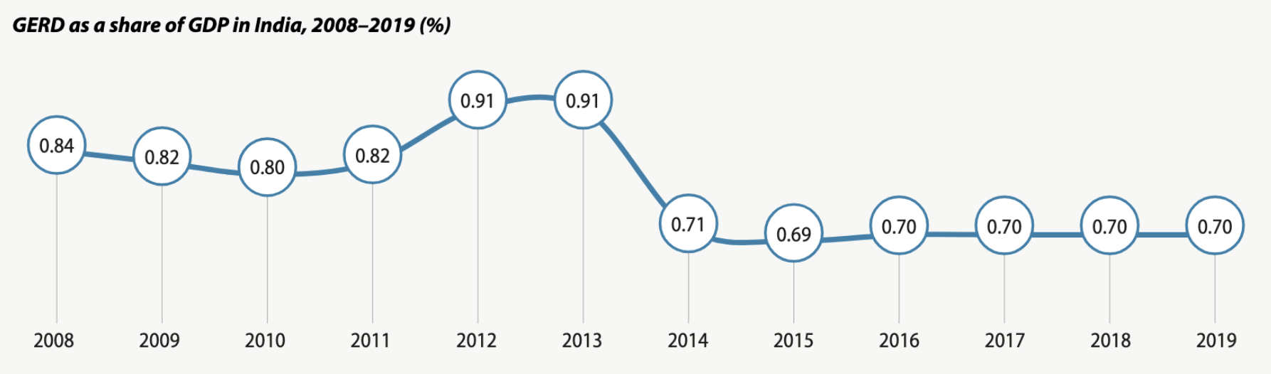
What is the problem? Generally, there is very little investment in R&D from the public sector in the Global South
LatAm: <0.70
Brazil: 1.26
~2.3 EU
UNESCO (2021)
Notes:
GERD: Gross domestic expenditure on R&D

Slide 21
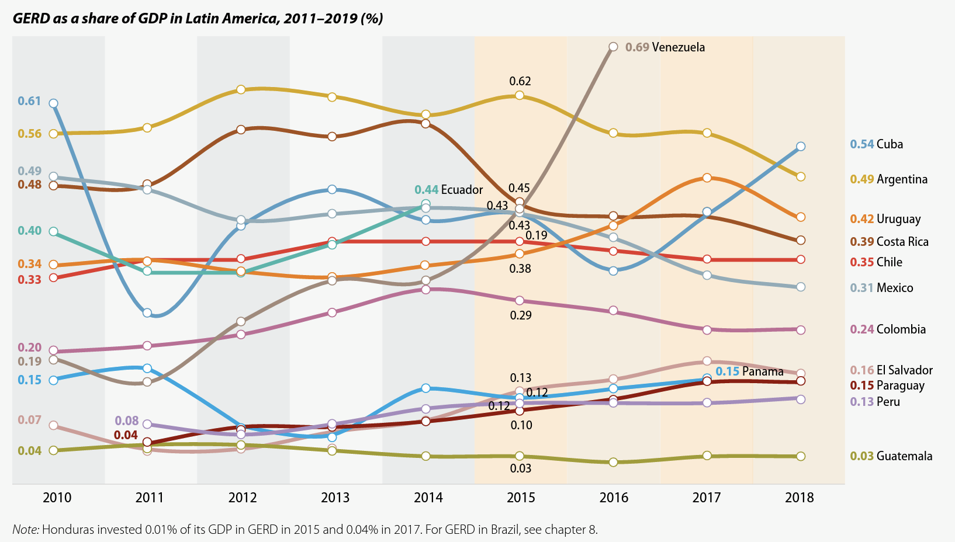
What is the problem? There is very little investment in R&D from the public sector in Latin America
LatAm: <0.70
Brazil: 1.26
~2.3 EU
UNESCO (2021)
Notes:
GERD: Gross domestic expenditure on R&D

Slide 22
There is an underrepresentation of samples of non-European ancestry in public repositories, and fewer studies in general being carried out in the Global South, linked to little available funding for scientific research

Slide 23
Outline
Background: The importance of studying diverse populations to understand disease processes
What is the problem?
Very little representation of non-European samples in public repositories
Very few studies being conducted outside de Global North
Why does it exist?
Lack of support for studies being conduced in the Global South
‘Helicopter’ science
How can we solve it?
More equitable scientific partnerships
Facilitating access to funding
Expanding representation in scientific boards, conferences, etc
Conclusions

Slide 24
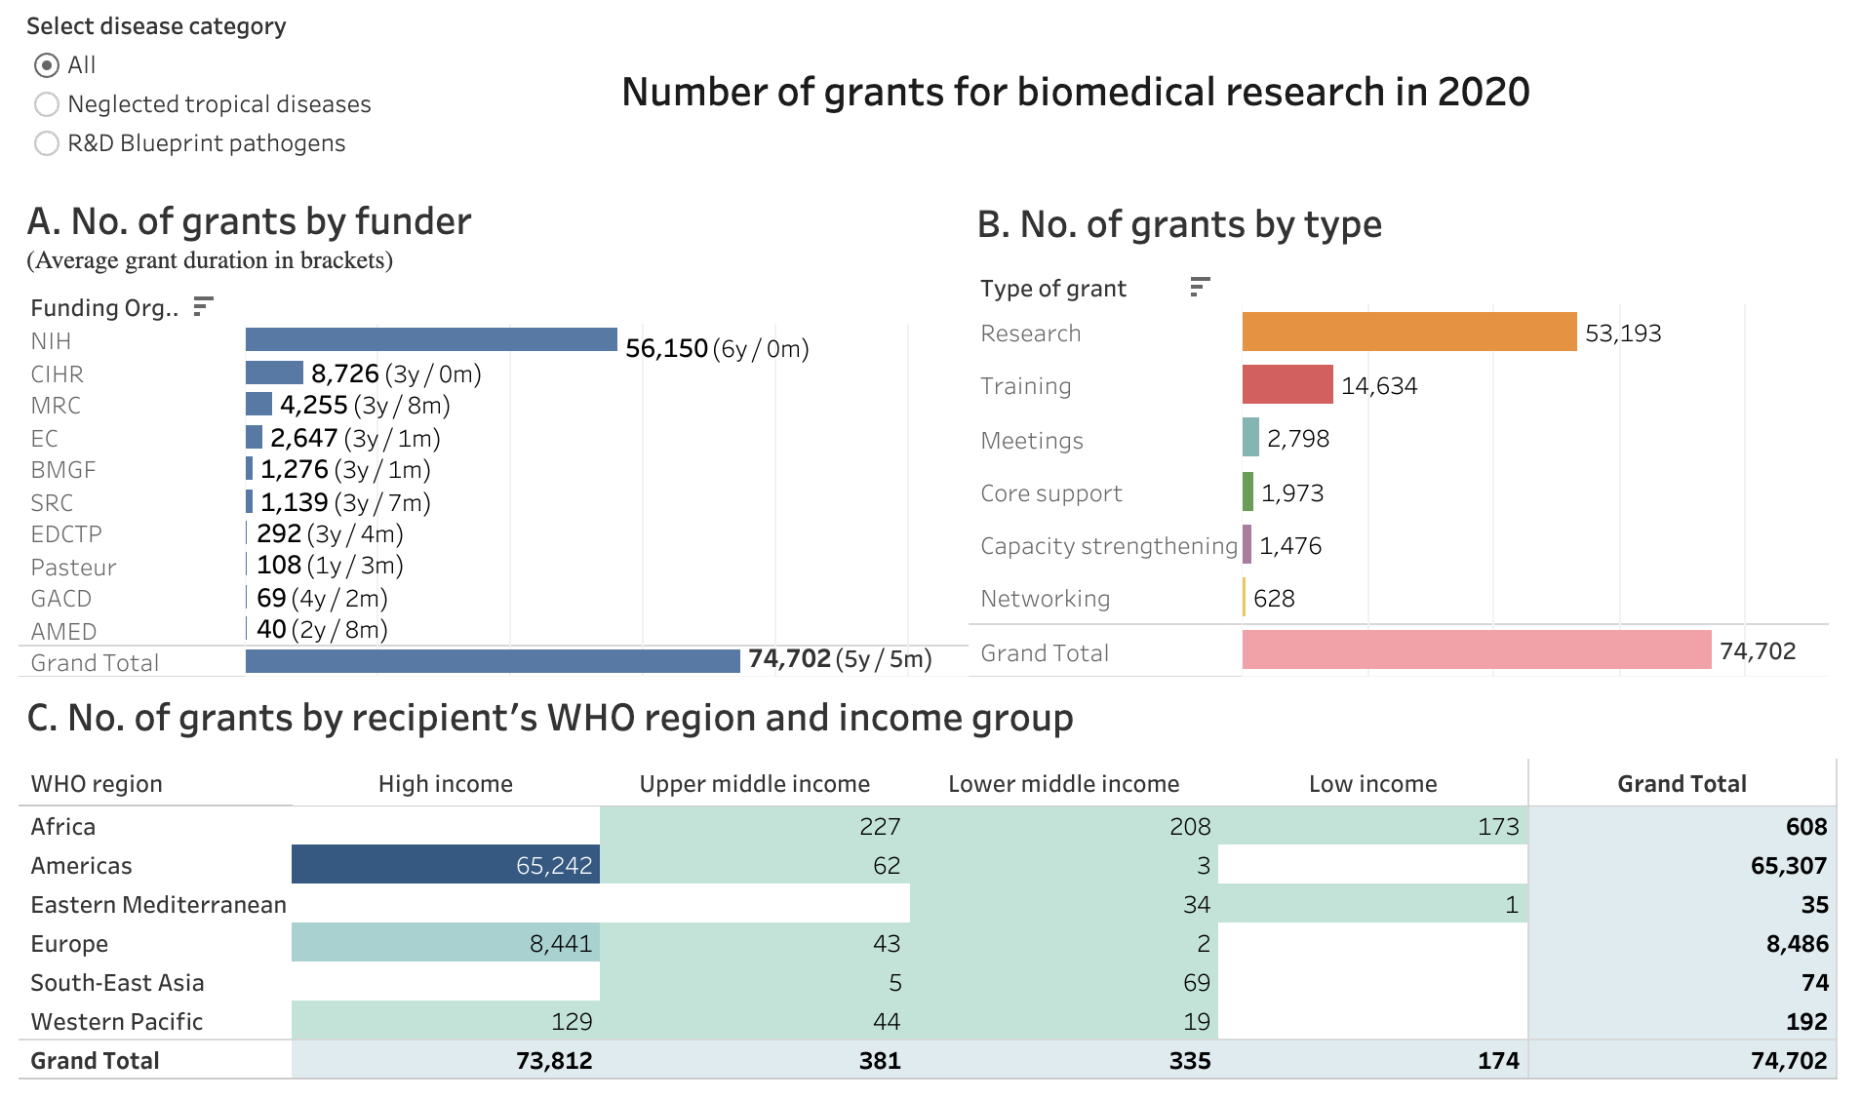
Why does it exist? Few grants for studies being done in the Global South
WHO (2020)
Notes:
CIHR – Canadian Institutes of Health Research
Medical Research Council
European Commission
Bill and Melinda Gates Foundation

Slide 25
Why does it exist? Few grants for studies being done in the Global South
99%
WHO (2020)

Slide 26
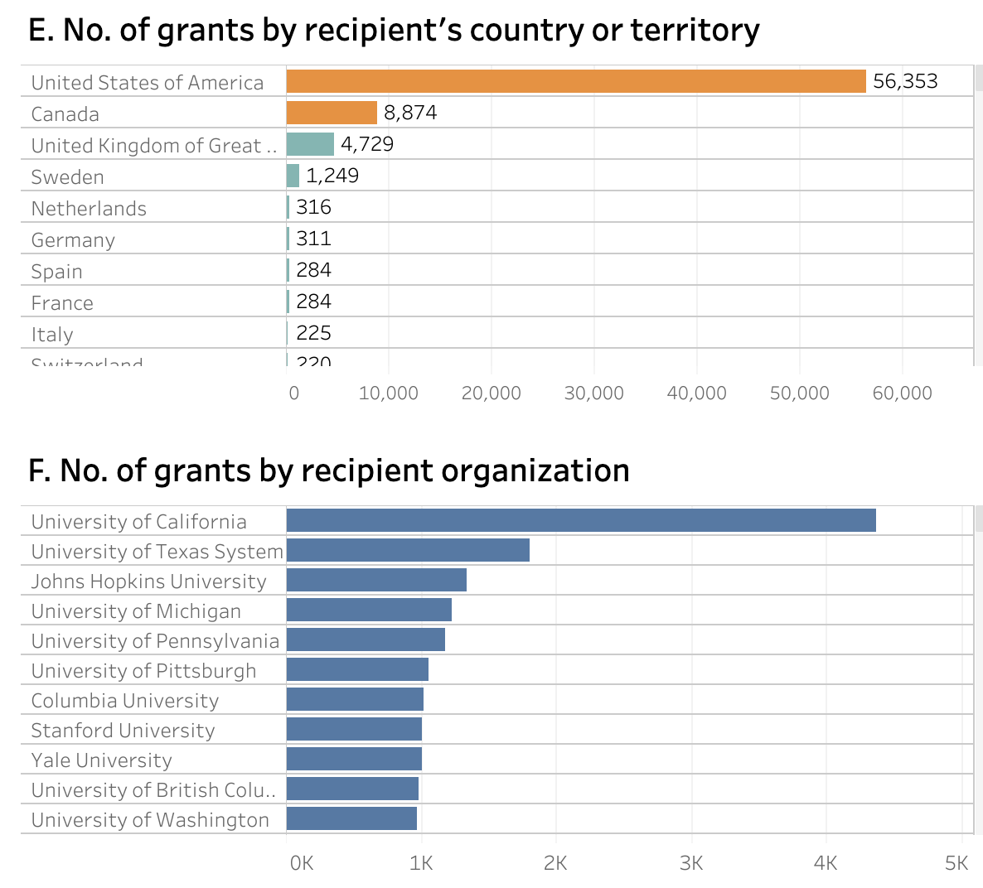
Why does it exist? Few grants for studies being done in the Global South
WHO (2020)

Slide 27
Why does it exist? Few grants for studies being done in the Global South
Brain drain
Job insecurity
Poor infrastructure
WHO (2020)

Slide 28
Why does it exist? Few grants for studies being done in the Global South
Brain drain
Job insecurity
Poor infrastructure
Scientific partnerships
WHO (2020)

Slide 29

Scientific partneships can be great
Enhance knowledge sharing
Complementary expertise more exciting science!
Complementary infrastructure
Progress research at a faster pace
Cost sharing
Opportunities for internships and
secondments
…

Slide 30
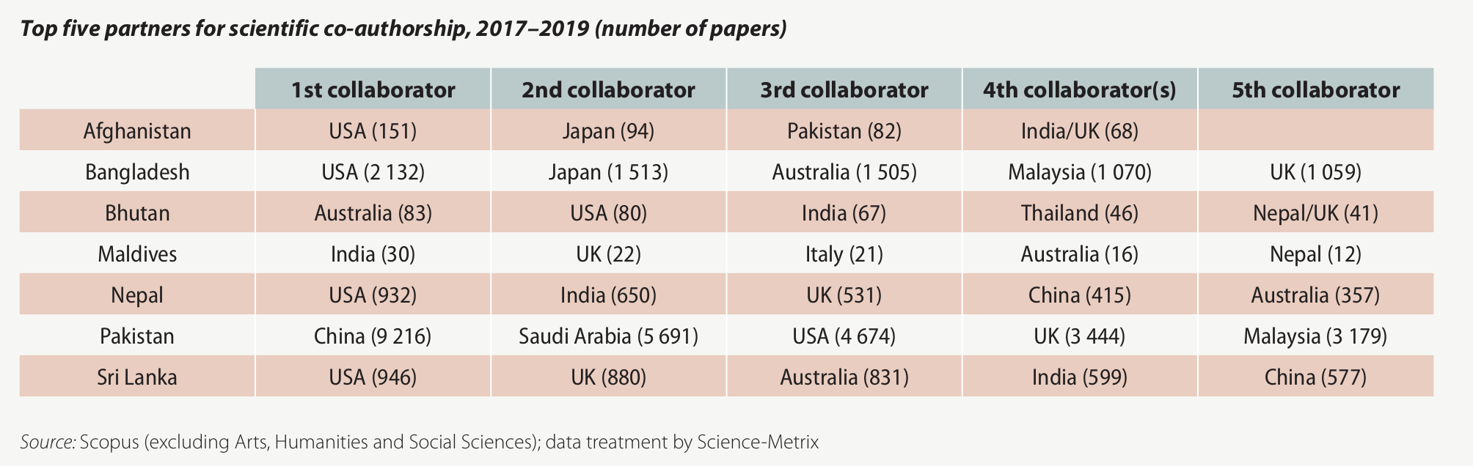
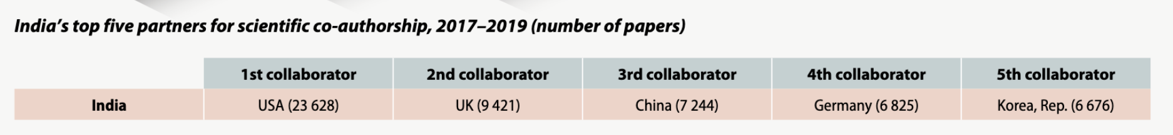
Collaboration partners
South Asia
India
UNESCO (2021)
Notes:
Linked to funding
ethics, government and banking regulations make doing this hard, but also of course, funding is probably the most important factor

Slide 31
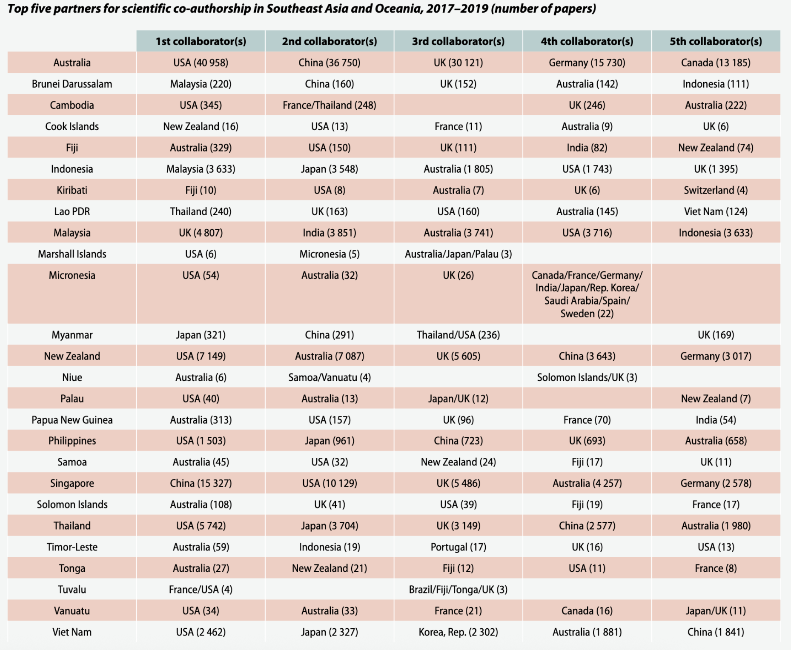
Collaboration partners
Southeast Asia and Oceania
UNESCO (2021)
Notes:
Linked to funding
ethics, government and banking regulations make doing this hard, but also of course, funding is probably the most important factor

Slide 32
Helicopter science and loss of trust
“Neo-colonial research or neo-colonial science, frequently described as helicopter research, parachute science or research, parasitic research, or safari study, is when researchers from wealthier countries go to a developing country, collect information, travel back to their country, analyze the data and samples, and publish the results with no or little involvement of local researchers.” – Wikipedia
“In the medical world: "A popular term for a clinical or epidemiologic research project conducted by foreign scientists who use local contacts to gain access to a population group and obtain samples” – FreeDictionary.com

Slide 33
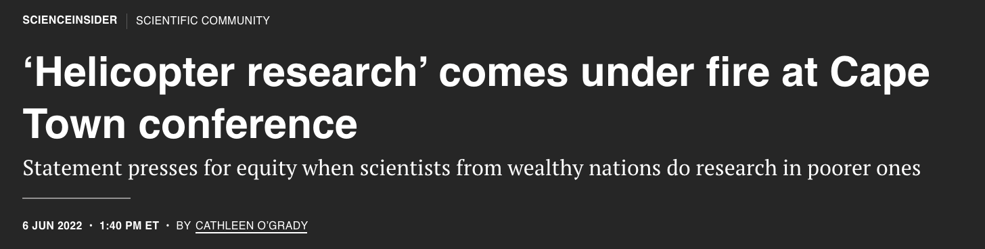
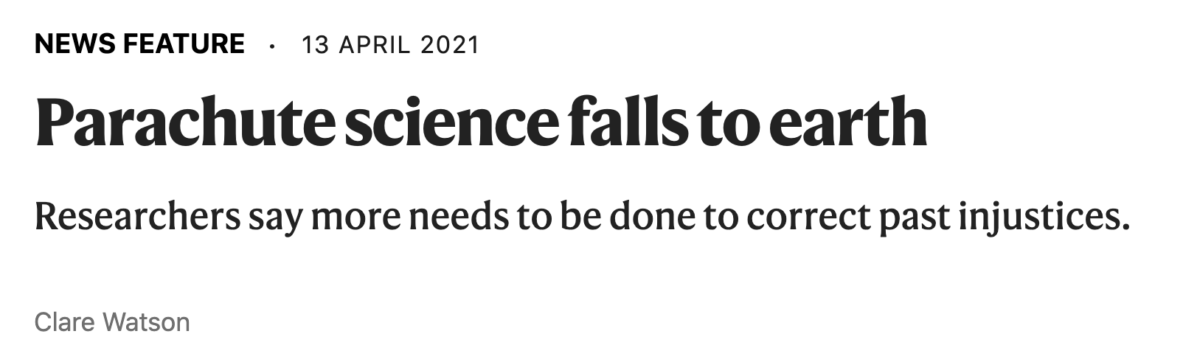
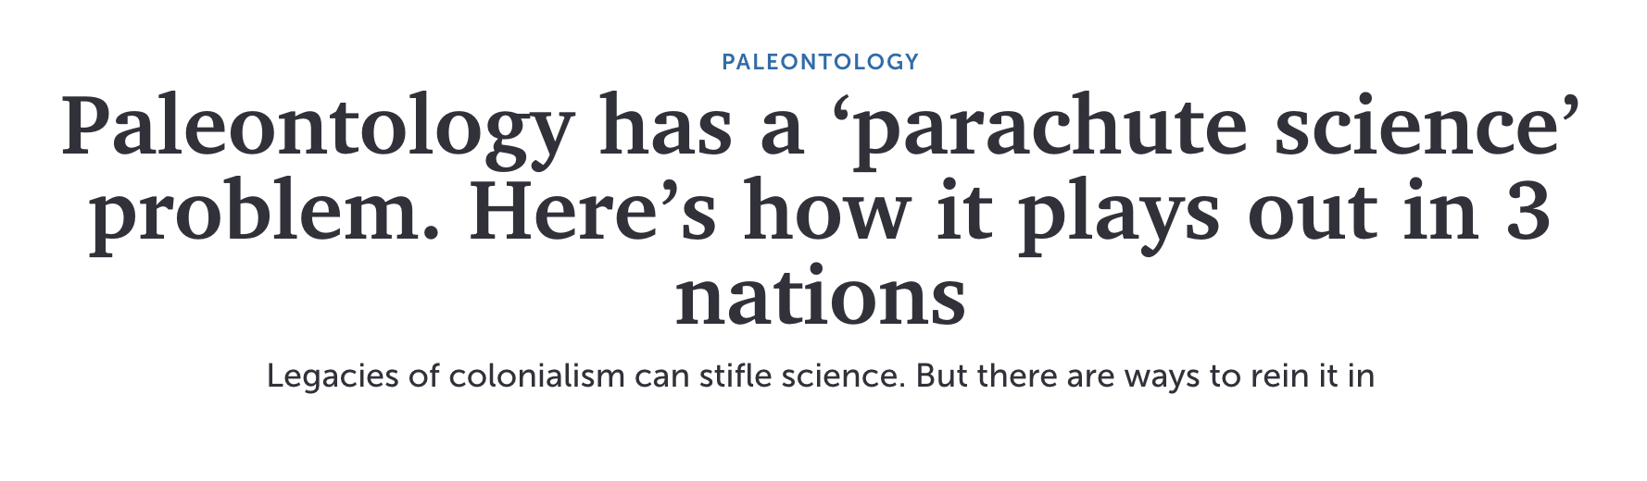
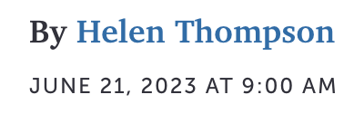
Helicopter science and loss of trust
Notes:
Usually can be seen when studies that have studied samples from other countries, in these cases Brazil, Mexico, Myanmar, a number of countries in Africa,

Slide 34
Helicopter science and loss of trust
Examples in oncology:
Clinical trials with exploitative practices have been run in low- and middle-income countries (LMICs), including Latin America
Cancer drug approval in LMICs that have hosted clinical trials is much slower than that in HICs,
In many cases, these drugs are also too expensive for patients in LMICs to access
Grover et al., 2016; Gyawali et al., 2022, Fundytus et al., 2021; Miller et al., 2021
Notes:
substandard control arms – that is, comparing a new treatment against a suboptimal treatment instead of the standard-of-care treatment under the guise of local inaccessibility to the standard of care

Slide 35
Considerations: Ethics for sample collecting
Samples should be treated as donations and research involving samples should be conducted with respect and transparency
Potential benefit from the research should outweigh any risks to the donors
Maximise the use of samples to benefit science and society
Decide whether and how feedback should be provided
The human body and its parts should not give rise to direct financial gain
Information provided to potential donors should be understandable and helpful
UKRI
Notes:
The physical risks in donating samples for research will usually be minimal, but the risk that information from laboratory tests or linked data of a sample might harm the donor or their interests must not be overlooked.

Slide 36
Considerations: Ethics for sample collecting
Samples should be treated as donations and research involving samples should be conducted with respect and transparency
Potential benefit from the research should outweigh any risks to the donors
Maximise the use of samples to benefit science and society
Decide whether and how feedback should be provided
The human body and its parts should not give rise to direct financial gain
Information provided to potential donors should be understandable and helpful
UKRI
Notes:
The physical risks in donating samples for research will usually be minimal, but the risk that information from laboratory tests or linked data of a sample might harm the donor or their interests must not be overlooked.

Slide 37
Considerations: Ethics for sample collecting
Samples should be treated as donations and research involving samples should be conducted with respect and transparency
Potential benefit from the research should outweigh any risks to the donors
Maximise the use of samples to benefit science and society
Decide whether and how feedback should be provided
The human body and its parts should not give rise to direct financial gain
Information provided to potential donors should be understandable and helpful
UKRI
Notes:
The physical risks in donating samples for research will usually be minimal, but the risk that information from laboratory tests or linked data of a sample might harm the donor or their interests must not be overlooked.

Slide 38
Considerations: Ethics for sample collecting
Samples should be treated as donations and research involving samples should be conducted with respect and transparency
Potential benefit from the research should outweigh any risks to the donors
Maximise the use of samples to benefit science and society
Decide whether and how feedback should be provided
The human body and its parts should not give rise to direct financial gain
Information provided to potential donors should be understandable and helpful
UKRI
Notes:
The physical risks in donating samples for research will usually be minimal, but the risk that information from laboratory tests or linked data of a sample might harm the donor or their interests must not be overlooked.

Slide 39
Considerations: Ethics for sample collecting
Samples should be treated as donations and research involving samples should be conducted with respect and transparency
Potential benefit from the research should outweigh any risks to the donors
Maximise the use of samples to benefit science and society
Decide whether and how feedback should be provided
The human body and its parts should not give rise to direct financial gain
Information provided to potential donors should be understandable and helpful
UKRI
Notes:
The physical risks in donating samples for research will usually be minimal, but the risk that information from laboratory tests or linked data of a sample might harm the donor or their interests must not be overlooked.

Slide 40
Considerations: Ethics for sample collecting
Samples should be treated as donations and research involving samples should be conducted with respect and transparency
Potential benefit from the research should outweigh any risks to the donors
Maximise the use of samples to benefit science and society
Decide whether and how feedback should be provided
The human body and its parts should not give rise to direct financial gain
Information provided to potential donors should be understandable and helpful
UKRI
Notes:
The physical risks in donating samples for research will usually be minimal, but the risk that information from laboratory tests or linked data of a sample might harm the donor or their interests must not be overlooked.

Slide 41
Considerations: Ethics for sample collecting
Patients should be informed when material left over following diagnosis or treatment may be used for research
Research involving human biological material should undergo independent ethical review, with very limited exceptions
Researchers should treat as confidential all personal and medical information
Researchers should keep up to date with all ethical, legislative, regulatory and governance requirements
UKRI
Notes:
The physical risks in donating samples for research will usually be minimal, but the risk that information from laboratory tests or linked data of a sample might harm the donor or their interests must not be overlooked.

Slide 42
Considerations: Ethics for sample collecting
Patients should be informed when material left over following diagnosis or treatment may be used for research
Research involving human biological material should undergo independent ethical review, with very limited exceptions
Researchers should treat as confidential all personal and medical information
Researchers should keep up to date with all ethical, legislative, regulatory and governance requirements
UKRI
Notes:
The physical risks in donating samples for research will usually be minimal, but the risk that information from laboratory tests or linked data of a sample might harm the donor or their interests must not be overlooked.

Slide 43
Considerations: Ethics for sample collecting
Patients should be informed when material left over following diagnosis or treatment may be used for research
Research involving human biological material should undergo independent ethical review, with very limited exceptions
Researchers should treat as confidential all personal and medical information
Researchers should keep up to date with all ethical, legislative, regulatory and governance requirements
UKRI
Notes:
The physical risks in donating samples for research will usually be minimal, but the risk that information from laboratory tests or linked data of a sample might harm the donor or their interests must not be overlooked.

Slide 44
Considerations: Ethics for sample collecting
Patients should be informed when material left over following diagnosis or treatment may be used for research
Research involving human biological material should undergo independent ethical review, with very limited exceptions
Researchers should treat as confidential all personal and medical information
Researchers should keep up to date with all ethical, legislative, regulatory and governance requirements
UKRI
Notes:
The physical risks in donating samples for research will usually be minimal, but the risk that information from laboratory tests or linked data of a sample might harm the donor or their interests must not be overlooked.

Slide 45
Considerations: Ethics for sample collecting
Who owns the data?
Who will do the analysis, and should results be fed back to the participants?
Should data be made public? What would be the benefits and risks?
How should samples be consented for “future use”, and should they?
Should you always strive to collect diverse samples?
What happens if discoveries from patient samples lead to commercial products or patents?
Beyond individual consent, should community-level consultation or agreements be sought?
Notes:
substandard control arms – that is, comparing a new treatment against a suboptimal treatment instead of the standard-of-care treatment under the guise of local inaccessibility to the standard of care

Slide 46
Considerations: Ethics for sample collecting
Who owns the data?
Who will do the analysis, and should results be fed back to the participants?
Should data be made public? What would be the benefits and risks?
How should samples be consented for “future use”, and should they?
Should you always strive to collect diverse samples?
What happens if discoveries from patient samples lead to commercial products or patents?
Beyond individual consent, should community-level consultation or agreements be sought?
Notes:
substandard control arms – that is, comparing a new treatment against a suboptimal treatment instead of the standard-of-care treatment under the guise of local inaccessibility to the standard of care

Slide 47
Considerations: Ethics for sample collecting
Who owns the data?
Who will do the analysis, and should results be fed back to the participants?
Should data be made public? What would be the benefits and risks?
How should samples be consented for “future use”, and should they?
Should you always strive to collect diverse samples?
What happens if discoveries from patient samples lead to commercial products or patents?
Beyond individual consent, should community-level consultation or agreements be sought?
Notes:
substandard control arms – that is, comparing a new treatment against a suboptimal treatment instead of the standard-of-care treatment under the guise of local inaccessibility to the standard of care

Slide 48
Considerations: Ethics for sample collecting
Who owns the data?
Who will do the analysis, and should results be fed back to the participants?
Should data be made public? What would be the benefits and risks?
How should samples be consented for “future use”, and should they?
Should you always strive to collect diverse samples?
What happens if discoveries from patient samples lead to commercial products or patents?
Beyond individual consent, should community-level consultation or agreements be sought?
Notes:
substandard control arms – that is, comparing a new treatment against a suboptimal treatment instead of the standard-of-care treatment under the guise of local inaccessibility to the standard of care

Slide 49
Considerations: Ethics for sample collecting
Who owns the data?
Who will do the analysis, and should results be fed back to the participants?
Should data be made public? What would be the benefits and risks?
How should samples be consented for “future use”, and should they?
Should you always strive to collect diverse samples?
What happens if discoveries from patient samples lead to commercial products or patents?
Beyond individual consent, should community-level consultation or agreements be sought?
Notes:
substandard control arms – that is, comparing a new treatment against a suboptimal treatment instead of the standard-of-care treatment under the guise of local inaccessibility to the standard of care

Slide 50
Considerations: Ethics for sample collecting
Who owns the data?
Who will do the analysis, and should results be fed back to the participants?
Should data be made public? What would be the benefits and risks?
How should samples be consented for “future use”, and should they?
Should you always strive to collect diverse samples?
What happens if discoveries from patient samples lead to commercial products or patents?
Beyond individual consent, should community-level consultation or agreements be sought?
Notes:
substandard control arms – that is, comparing a new treatment against a suboptimal treatment instead of the standard-of-care treatment under the guise of local inaccessibility to the standard of care

Slide 51
Considerations: Ethics for sample collecting
Who owns the data?
Who will do the analysis, and should results be fed back to the participants?
Should data be made public? What would be the benefits and risks?
How should samples be consented for “future use”, and should they?
Should you always strive to collect diverse samples?
What happens if discoveries from patient samples lead to commercial products or patents?
Beyond individual consent, should community-level consultation or agreements be sought?
Notes:
substandard control arms – that is, comparing a new treatment against a suboptimal treatment instead of the standard-of-care treatment under the guise of local inaccessibility to the standard of care

Slide 52
There is scarce funding going into research and development activities in the Global South. Scientific partnerships with HICs can be a great solution, but we must also be careful - ‘helicopter science’ practices can lead to loss of trust

Slide 53
Outline
Background: The importance of studying diverse populations to understand disease processes
What is the problem?
Very little representation of non-European samples in public repositories
Very few studies being conducted outside de Global North
Why does it exist?
Lack of support for studies being conduced in the Global South
‘Helicopter’ science
How can we solve it?
More equitable scientific partnerships
Facilitating access to funding
Expanding representation in scientific boards, conferences, etc
Conclusions

Slide 54
How can we solve it?
Channel more funding to Global South teams – and ask for it!
Promote (and demand) equitable research partnerships
Capacity building
Training opportunities both ways
Recognition of experience and value
Support Latin American (and LMIC) partners so they can meet data availability requirements
Facilitate publishing of Latin American (and LMIC)-led research
Journal discounts
Language
Increase representation of Latin American scientists at all levels (in research labs, in publishing, in conferences)
Notes:
There are highly qualified people there – we just need infrastructure and support

Slide 55







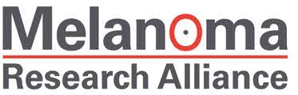
How can we solve it?
Channel more funding to Global South teams – and ask for it!
Promote (and demand) equitable research partnerships
Capacity building
Training opportunities both ways
Recognition of experience and value
Support Latin American (and LMIC) partners so they can meet data availability requirements
Facilitate publishing of Latin American (and LMIC)-led research
Journal discounts
Language
Increase representation of Latin American scientists at all levels (in research labs, in publishing, in conferences)
Global South PIs are now eligible for many international funding calls

Slide 56
How can we solve it?
Channel more funding to Global South teams
Promote (and demand) equitable research partnerships
Capacity building
Training opportunities both ways
Recognition of experience and value
Support Latin American (and LMIC) partners so they can meet data availability requirements
Facilitate publishing of Latin American (and LMIC)-led research
Journal discounts
Language
Increase representation of Latin American scientists at all levels (in research labs, in publishing, in conferences)

Slide 57
How can we solve it?
Channel more funding to Global South teams
Promote (and demand) equitable research partnerships
Capacity building
Training opportunities both ways
Recognition of experience and value
Support Latin American (and LMIC) partners so they can meet data availability requirements
Facilitate publishing of Latin American (and LMIC)-led research
Journal discounts
Language
Increase representation of Latin American scientists at all levels (in research labs, in publishing, in conferences)

Slide 58






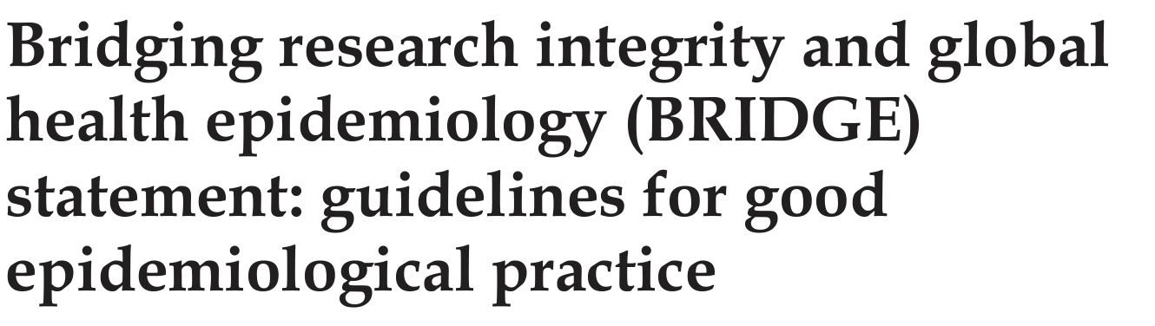
How can we solve it?
Channel more funding to Latin American-led teams
Promote (and demand) equitable research partnerships
Capacity building
Training opportunities both ways
Recognition of experience and value
Support Latin American (and LMIC) partners so they can meet data availability requirements
Facilitate publishing of Latin American (and LMIC)-led research
Journal discounts
Language
Increase representation of Latin American scientists at all levels (in research labs, in publishing, in conferences)
Cape Town Statement
Notes:
Organisations that aim to foster sustainable partnerships when working with LMICs
Research Fairness Initiative – organisational research tool that has identified 15 key áreas for sustainable partnerships, aimed at establishing collaborations at the governmental, academic and corporate levels involving LMIC partners

Slide 59
How can we solve it?
Channel more funding to Global South teams
Promote (and demand) equitable research partnerships
Capacity building
Training opportunities both ways
Recognition of experience and value
Support Global South partners so they can meet data availability requirements
Facilitate publishing of Latin American (and LMIC)-led research
Journal discounts
Language
Increase representation of Latin American scientists at all levels (in research labs, in publishing, in conferences)

Slide 60
How can we solve it?
Channel more funding to Global South teams
Promote (and demand) equitable research partnerships
Capacity building
Training opportunities both ways
Recognition of experience and value
Support Global South partners so they can meet data availability requirements
Facilitate publishing of Global South-led research
Journal discounts
Language
Increase representation of Latin American scientists at all levels (in research labs, in publishing, in conferences)

Slide 61





How can we solve it?
Channel more funding to Global South teams
Promote (and demand) equitable research partnerships
Capacity building
Training opportunities both ways
Recognition of experience and value
Support Global South partners so they can meet data availability requirements
Facilitate publishing of Global South-led research
Journal discounts
Language
Increase representation of Latin American scientists at all levels (in research labs, in publishing, in conferences)

Slide 62
How can we solve it?
Channel more funding to Global South teams
Promote (and demand) equitable research partnerships
Capacity building
Training opportunities both ways
Recognition of experience and value
Support Global South partners so they can meet data availability requirements
Facilitate publishing of Global South-led research
Journal discounts
Language
Increase representation of Global South scientists at all levels (in research labs, in publishing, in conferences)

Slide 63
How can we solve it?
Channel more funding to Latin American-led teams
Promote (and demand) equitable research partnerships
Capacity building
Training opportunities both ways
Recognition of experience and value
Support Latin American (and LMIC) partners so they can meet data availability requirements
Facilitate publishing of Latin American (and LMIC)-led research
Journal discounts
Language
Increase representation of Latin American scientists at all levels (in research labs, in publishing, in conferences)
Notes:
Electronic information for libraries

Slide 64
A higher representation of Global South science at all levels (project leadership, published studies, scientific publishing, research conferences) will result in a higher representation of non-European samples in public repositories

Slide 65
Outline
Background: The importance of studying diverse populations to understand disease processes
What is the problem?
Very little representation of non-European samples in public repositories
Very few studies being conducted outside de Global North
Why does it exist?
Lack of support for studies being conduced in the Global South
‘Helicopter’ science
How can we solve it?
More equitable scientific partnerships
Facilitating access to funding
Expanding representation in scientific boards, conferences, etc
Conclusions

Slide 66
Conclusion
Supporting Global South researchers will increase the contribution that they make to research outputs, which will, in turn, increase the study of samples from these regions and thus the diversity of data hosted in large repositories.
This should be done in collaboration with international partners from the beginning and considering the needs and benefits for everyone involved
Notes:
a recent study found that only ∼6.5% of cancer genomics studies using African biospecimens did not include any authors based in African institutions, although the study did not consider the evolution of authorship patterns through time (Rotimi et al., 2021). Furthermore, the proportion of LMIC-based authors in publications of oncology randomised controlled trials increased from 20% to 29% in the period from 1998 to 2008

Slide 67
Thank you!
Notes:
a recent study found that only ∼6.5% of cancer genomics studies using African biospecimens did not include any authors based in African institutions, although the study did not consider the evolution of authorship patterns through time (Rotimi et al., 2021). Furthermore, the proportion of LMIC-based authors in publications of oncology randomised controlled trials increased from 20% to 29% in the period from 1998 to 2008

